Slide 1

DIPLOMA IN COMPUTER SCIENCE ENGINEERING
Attendance system using QR Code and Face recognition
BY
S. PRAVEEN 21047-CS-012
P. NANDA KISHORE 21047-CS-016
D. VARSHINI SNIGDHA 21047-CS-002
P. SATHWIK REDDY 21047-CS-006
K. RAM CHARAN 21047-CS-014
G. CHIRU THEJ 21047-CS-054
Under the Guidance of
G. SREE MADHURI, M. Tech.,
LECTURER IN COMPUTER ENGINEERING

Slide 2




ATTENDANCE SYSTEM USING QR CODE AND FACE RECOGNITION
1

Slide 3
ABSTRACT :
This presentation introduces a contemporary attendance-tracking approach by fusing QR Code and Face Recognition technologies.
The system employs QR Codes for swift and efficient participant check-ins, reducing manual efforts and curbing proxy attendance.
Complemented by Face Recognition, the solution enhances accuracy and security, ensuring a seamless and reliable attendance management process.
This brief overview highlights the simplicity, speed, and heightened security brought about by integrating QR codes and Face Recognition for an advanced and efficient attendance system.
2

Slide 4
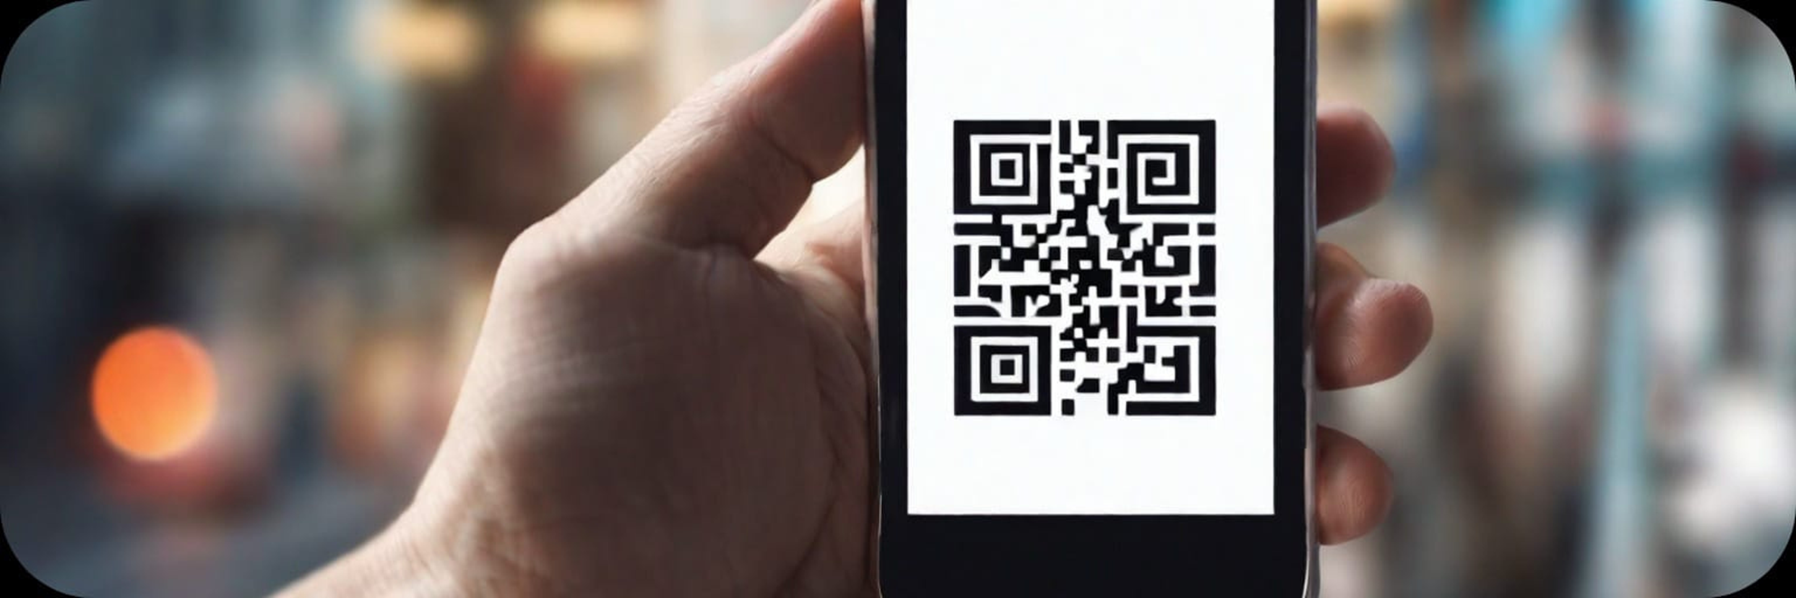
Introduction
The attendance system using QR code and face recognition is a modern solution for tracking and managing attendance in various settings, such as schools, workplaces, and events.
3

Slide 5

PROBLEM STATEMENT
FOR
“ATTENDANCE SYSTEM USING QR CODE AND FACE RECOGNITION”
The traditional methods of attendance management, such as manual roll call, paper-based records, or ID cards, are inefficient, time-consuming, and prone to errors. Moreover, they do not prevent the possibility of proxy attendance or impersonation. Therefore, there is a need for an automated, accurate, and secure attendance system that can verify the identity of the attendees and record their presence in a database.
4

Slide 6
EXISTING SYSTEM
The current attendance management system relies heavily on old-fashioned methods like paper registers and card swiping. Unfortunately, these methods have several drawbacks, making them less efficient.
Disadvantages:
• Inefficiencies
• Errors and Inaccuracies
• Time-Consuming Processes
• Limited Adaptability
• Prone to Fraud
• Dependency on Physical Presence
5

Slide 7
PROPOSED SYSTEM
Our advanced attendance management solution uses QR code technology and face recognition to streamline the process. This modern approach automates attendance, reduces the risk of proxy entries, and provides a user-friendly experience. The system offers improved adaptability, accuracy, and real-time functionality, marking a significant upgrade from traditional methods
Advantages:
• Automation Efficiency
• Proxy Prevention
• User-Friendly Interface
• Adaptability
• Accuracy and Real-Time Updates
• Enhanced Security
Lorna Alvarado
6

Slide 8
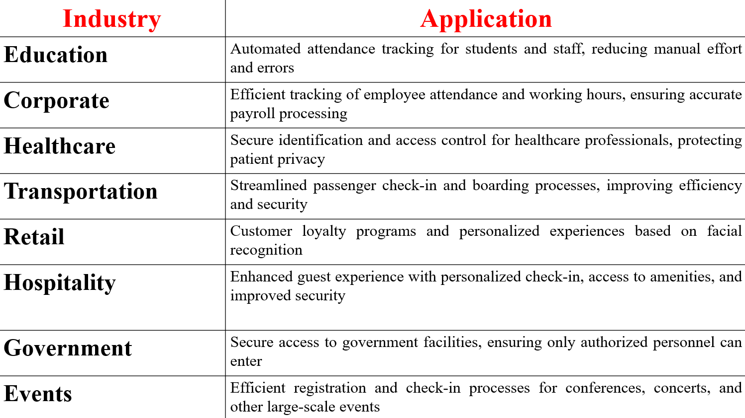
Application of the Project to the Real World
7

Slide 9
SYSTEM DIAGRAM
Start
Server ON
HOME PAGE
QR GENERATION
Name = input()
pin = input()
branch = intput()
NO
If
USER
IN
DB
YES
Name = input()
pin = input()
branch = intput()
QR-Code is
generated
Displays user Image & QR-Code
ADMIN PAGE
8

Slide 10
NO
If
ADMIN
YES
email = input()
password = input()
HOME PAGE
Displays all attendance of that date.
ADD FACE
Name = input()
branch = input()
pin = input()
75 Faces captures are stored in a separate file.
Attendance
9

Slide 11
QR-Code Scanning
If
QR-Code
data
matches
IN EXSISTED
QR-Codes
Face Recognition
If
Face Landmarks
array
matches
IN Saved model
Mark the Attendance in EXCEL sheet
STOP
ATTENDANCE
10

Slide 12
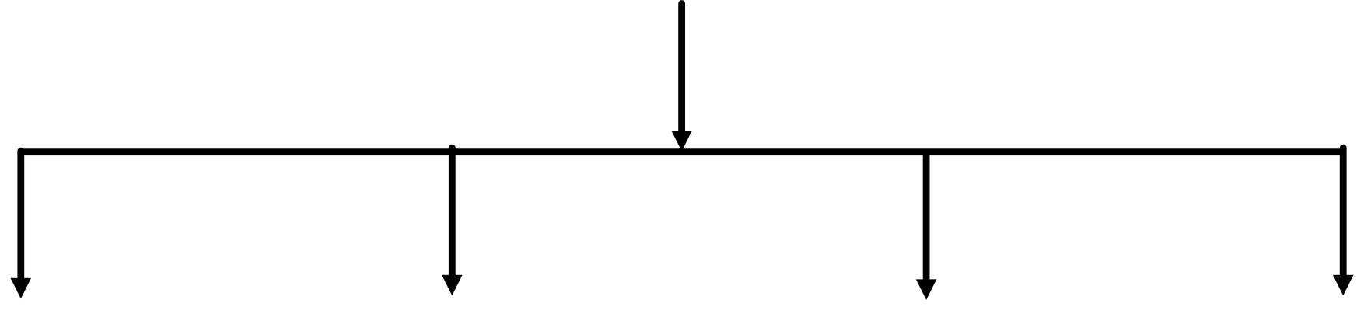

DATABASE
Attendance
Morning Attendance
Evening Attendance
Total Attendance
Image
Table
11

Slide 13
Morning Attendance Table: [ name, pin, branch, initial time ] these are the columns, and the use case is whenever the user takes the attendance before 10. Am, then the attendance will be inserted into this table so that know one can modify it except admin.
Evening Attendance Table: [ name, pin, branch, final time ] these are the columns, and the use case is whenever the user takes the attendance before 3.30 pm, then the attendance will be inserted into this table so that know one can modify it except admin.
Final Attendance Table: [ name, pin, branch, initial time, final time, time difference, status ] these are the columns, and the use case is the students who are present in the both morning table and evening table are inserted into the this table and this is the one considered for overall.
Image Table: [ name pin, images list ] these are the columns, and the use case is whenever the student add his face in the interface then the images are the directly inserted into this table in the binary format.
12

Slide 14

MACHINE LEARNING
Machine Learning is an artificial intelligence domain where we extract patterns from the data, analyze the data, and make intelligent predictions on the new data. It has three main types: supervised (labeled data), unsupervised (unlabeled data), and reinforcement (interaction-based learning).
Algorithms: Linear Regression,
Decision Trees, Neural Networks.
Applications: Image/Speech Recognition, Predictive Analytics, NLP, Recommendation Systems.
13

Slide 15
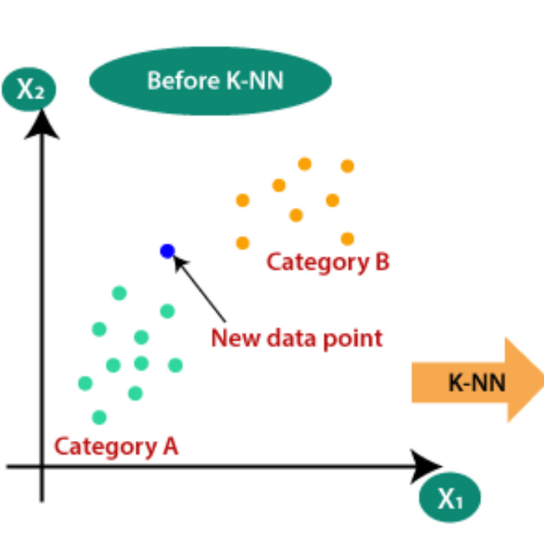
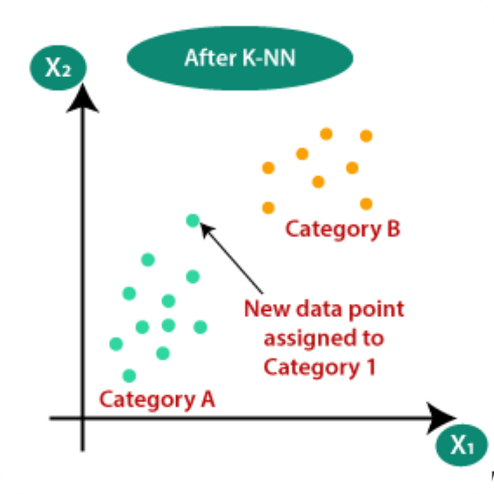
KNN ALGORITHM
What is the KNN Algorithm?
K-Nearest Neighbors (KNN) is a simple and intuitive algorithm used for both classification and regression tasks. It operates on the principle that data points close to each other in feature space are more likely to belong to the same class or have similar outputs.
Role of KNN Algorithm in the Attendance System
In the attendance system using QR code and face recognition, the KNN algorithm plays a crucial role in identifying and verifying individuals. It uses the features extracted from the QR code or facial image to compare and find the nearest neighbors in the database. By calculating the distances between the new data point and the existing data points, the KNN algorithm determines the closest matches and assigns the appropriate attendance status.
14

Slide 16

ABOUT OPENCV
OpenCV, or Open Source Computer Vision Library, is a widely used open-source software library for real-time computer vision and machine learning. It offers a range of tools for image processing, computer vision algorithms, and machine learning integration. With cross-platform support, it is employed in applications such as object detection, facial recognition, augmented reality, and robotics. OpenCV is written in C++ but has bindings for Python and other languages, making it accessible to a diverse community of developers. Its versatility and active community contribute to its significance in various computer vision projects.
15

Slide 17
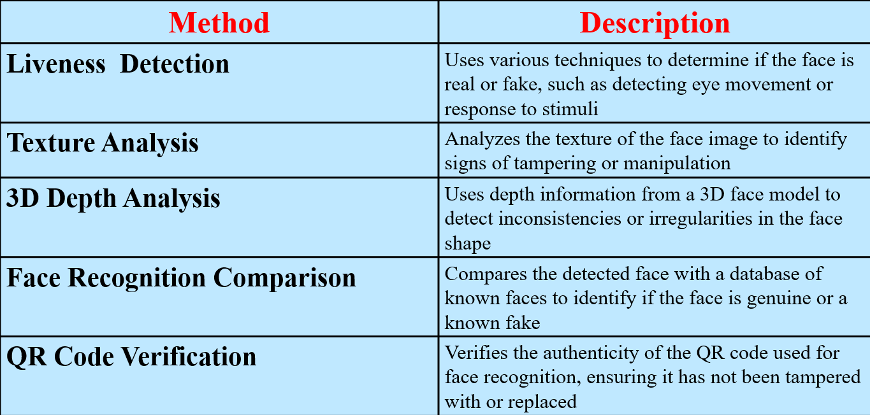
FAKE FACE DETECTION
16

Slide 18
TRAINING AND TESTING PROCESS
Data Collection and Preparation
Data is collected when users add their faces to the model, forming the dataset. This ensures that the system learns from diverse facial features, enhancing accuracy in face recognition.
Model Training
The project utilizes the K-Nearest Neighbors (KNN) algorithm for face classification. During model training, the algorithm learns patterns from the collected dataset to enable accurate face recognition.
Testing and Validation
Testing involves using the train-test-split method with a 20% test size. This ensures a robust evaluation of the model's performance, validating its effectiveness in accurately recognizing faces and handling diverse scenarios.
Ongoing Refinement
Continuous refinement is prioritized for the project. Regular updates to the dataset, algorithm, and error-handling mechanisms ensure adaptability to emerging challenges, maintaining the system's effectiveness in real-world scenarios.
17

Slide 19

Output screens
1
18

Slide 20
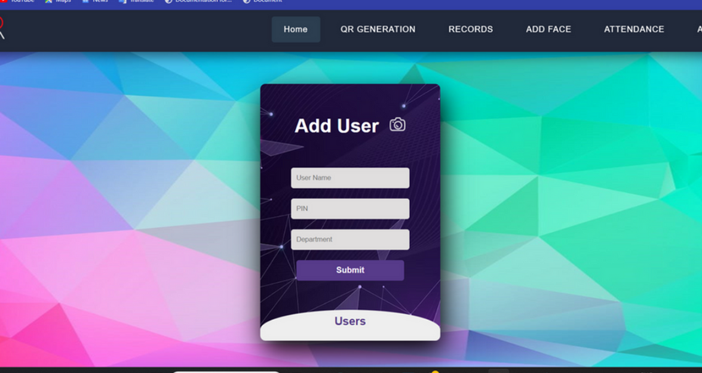
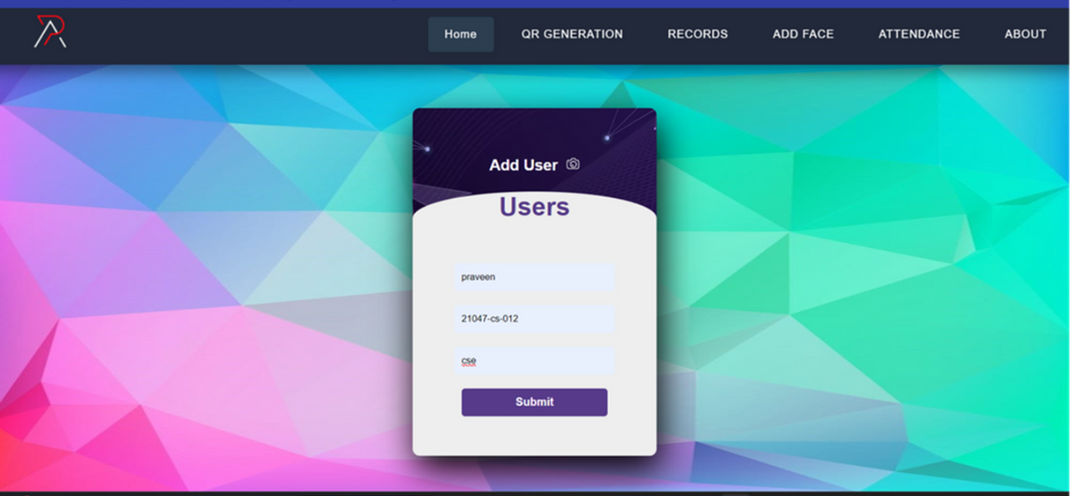
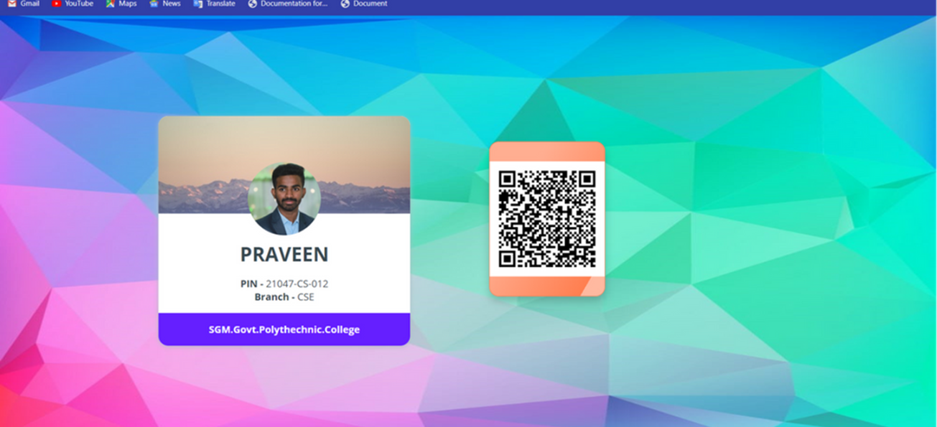
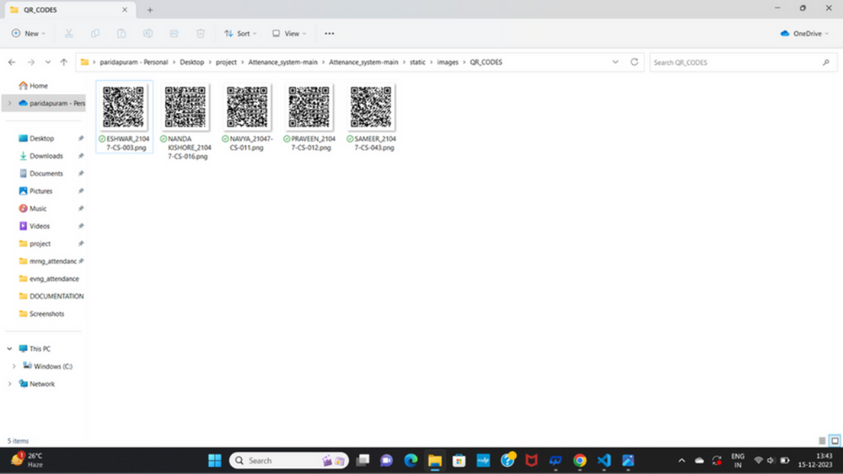
2
3
5
4
19

Slide 21
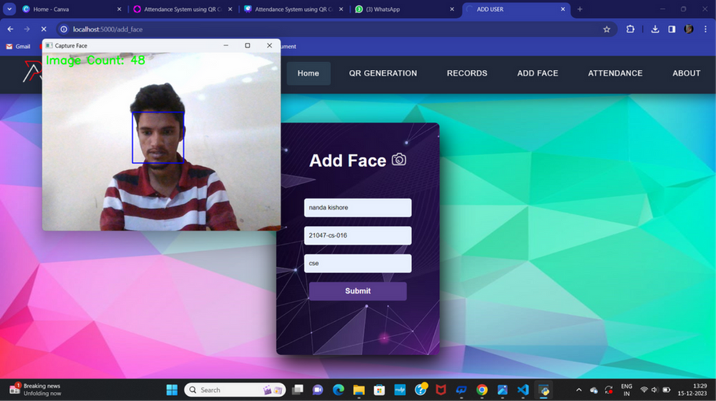
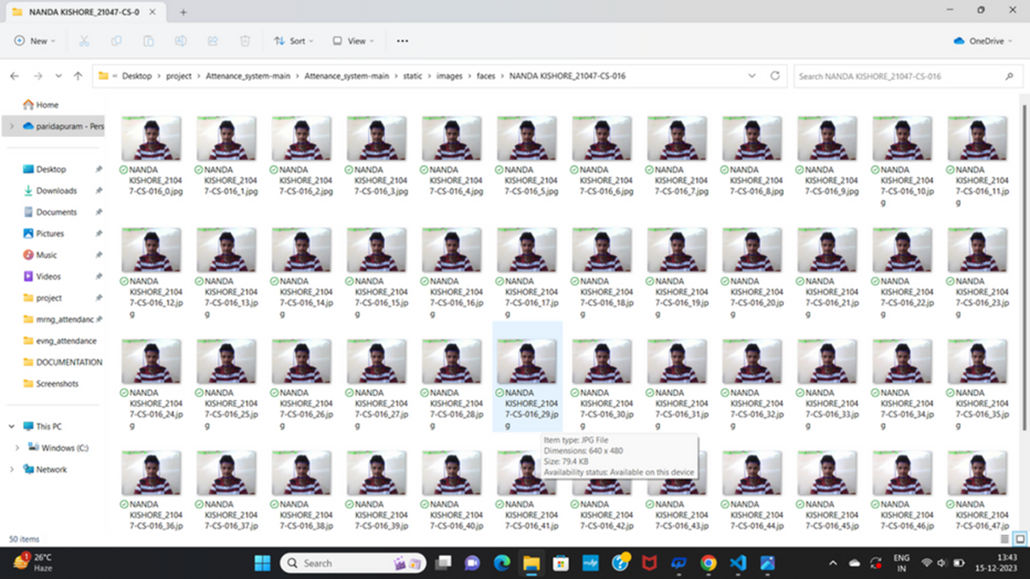
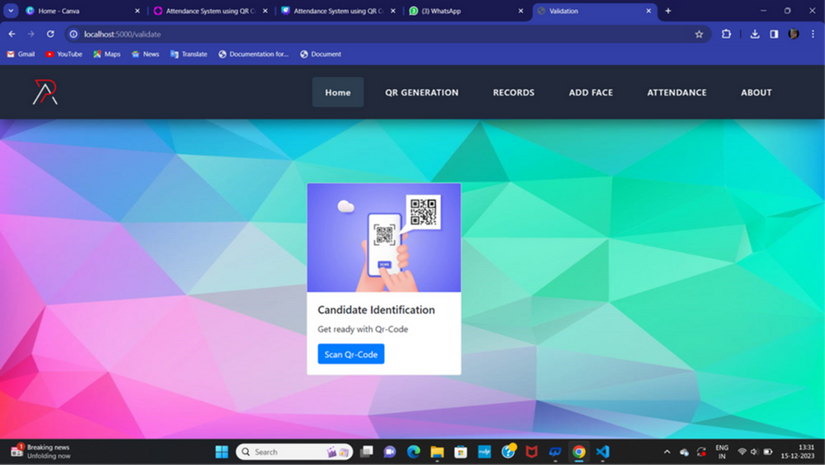
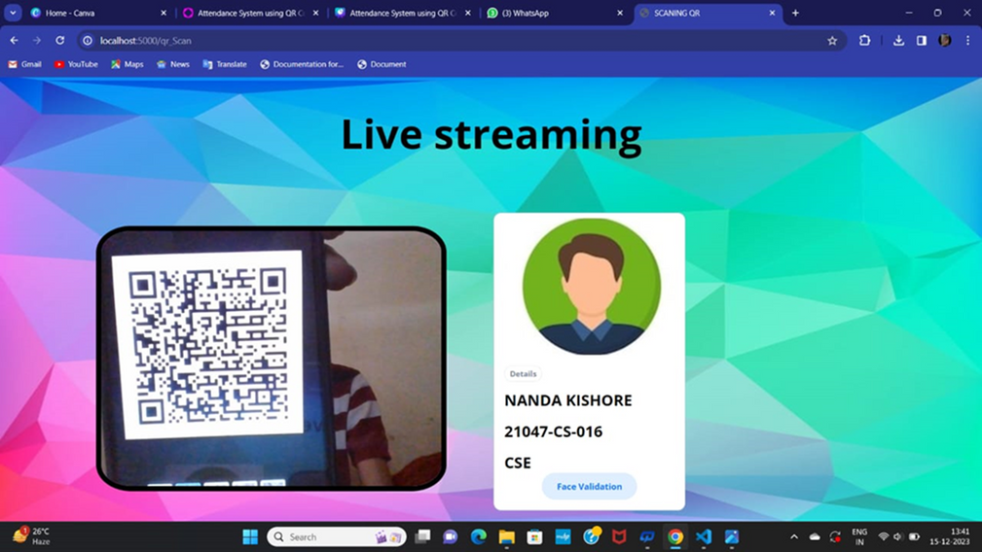
6
7
8
9
20

Slide 22
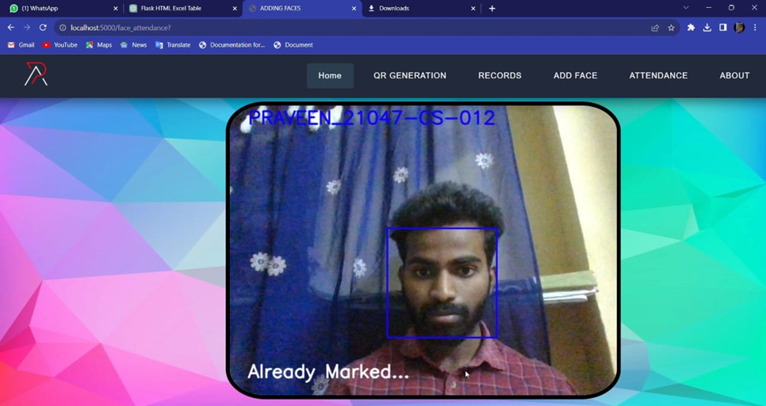
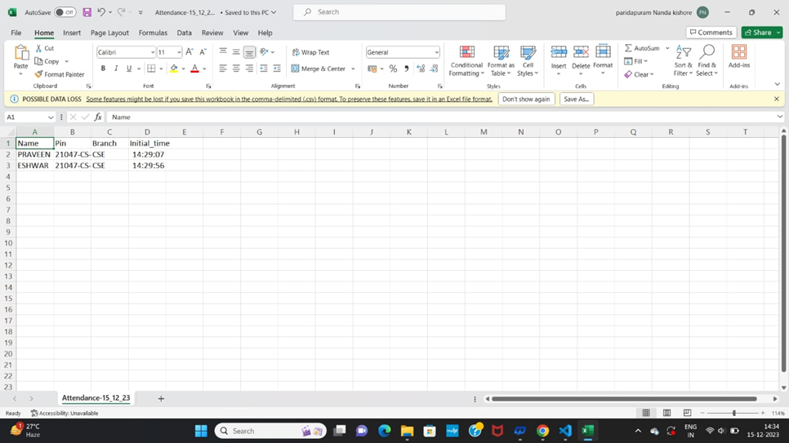
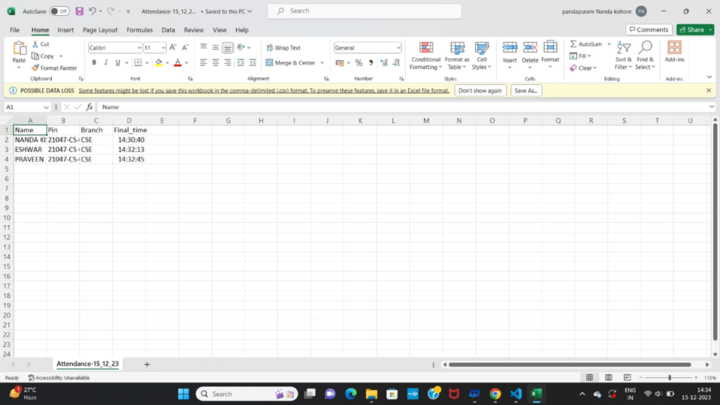
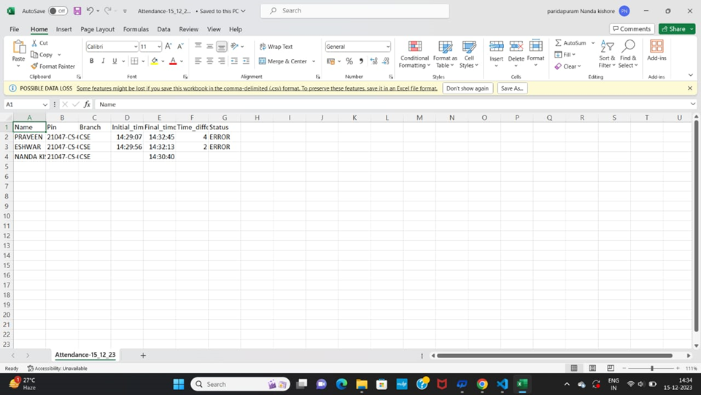
10
11
12
13
21

Slide 23
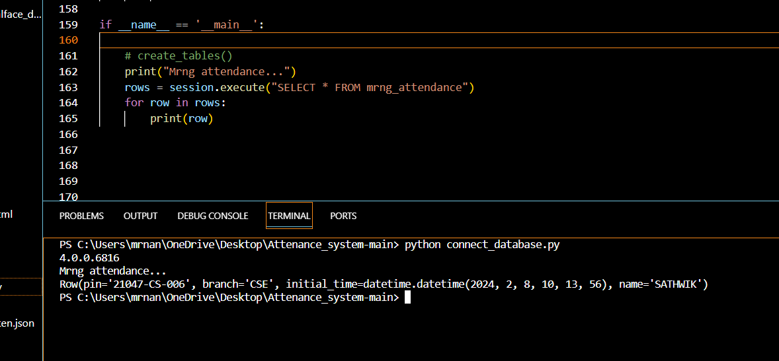
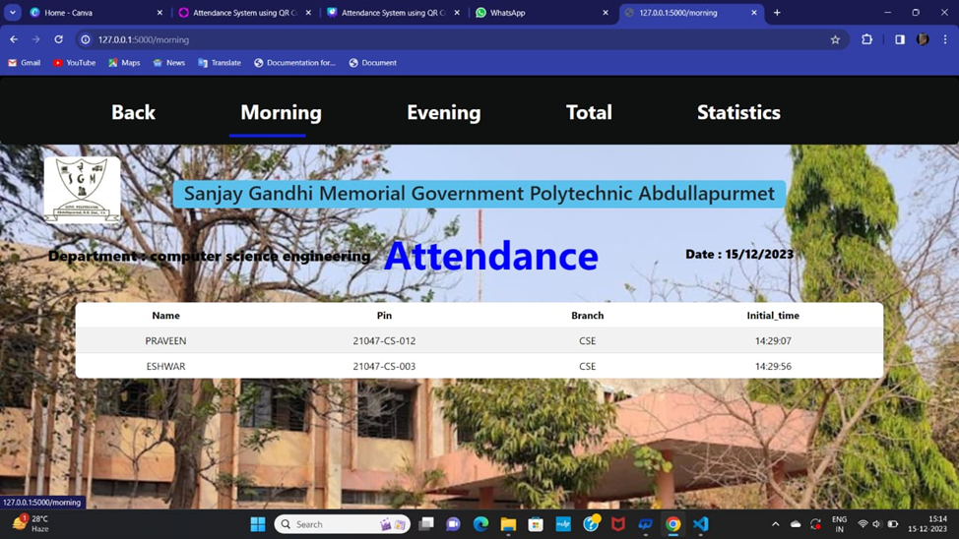
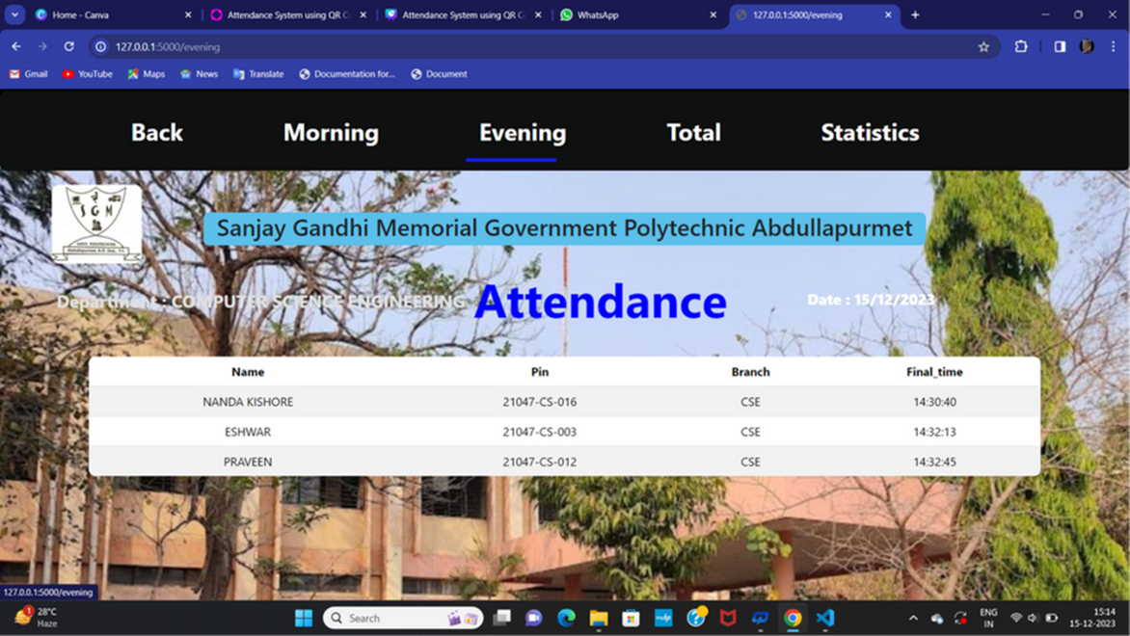
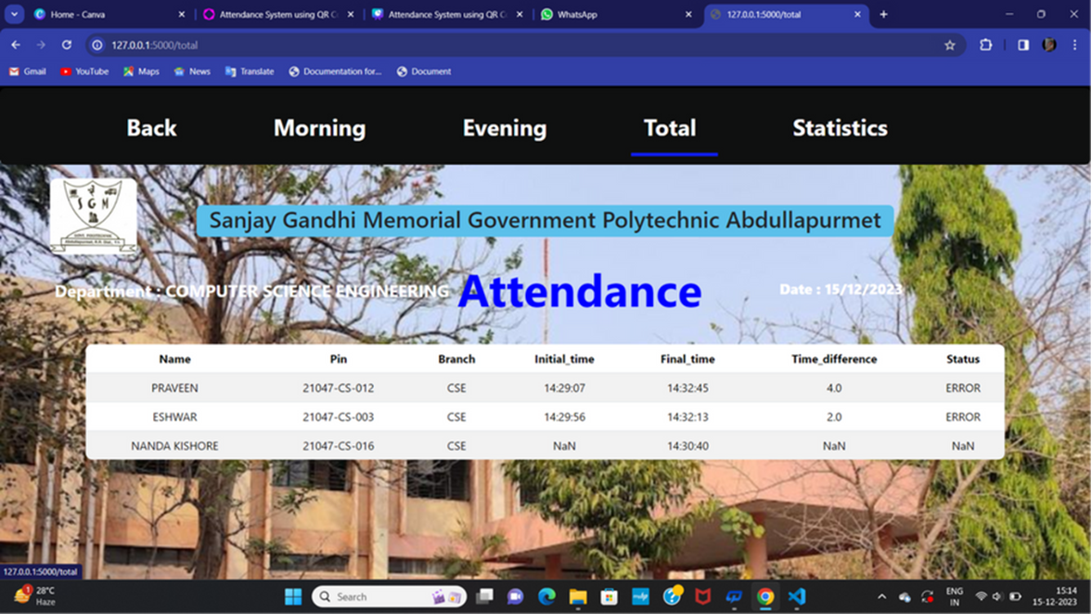
ATTENDANCE
14
15
16
17
22

Slide 24
Deployment and Maintenance
Deployment
Our machine learning-driven model is ready for deployment, and we've chosen Ngrok as our cloud service provider for this presentation. Ngrok offers a straightforward and efficient way to expose local services to the Internet, facilitating seamless testing and integration.
Maintenance
Regular maintenance will be required to keep the system running smoothly. This will involve monitoring the model performance and addressing any issues that arise. The KNN machine-learning models will need to be retrained periodically to ensure they are up-to-date and accurate. Additionally, Finally, our data sources will need to be maintained and updated as necessary to ensure the model is providing accurate information to users.
23

Slide 25
Conclusion
In conclusion, the "Attendance via QR-Code and Face Recognition" project represents a cutting-edge solution for attendance management, leveraging the synergies of QR code recognition and face detection technologies and integrating these advanced features, the system ensures efficient and precise attendance tracking across various domains. The dynamic QR code generation simplifies onboarding processes, while robust error handling safeguards against fraudulent practices, guaranteeing the system's reliability. The ability to log authenticated attendance in a CSV file enhances record-keeping, making this project a pioneering effort in streamlining and elevating the attendance management process.
24

Slide 26
THANK YOU
25

